Slide 1

Image Physics

Slide 2
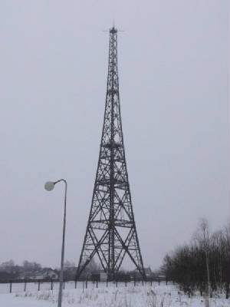
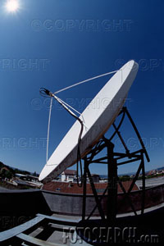
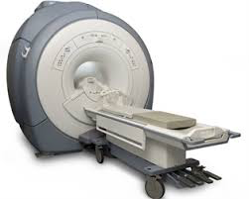
Reception
Radio Stimulus
Delay
Proton Interaction in Tissues
H₂0
H₂0
H₂0
Equilibrium State
Excited State
Equilibrium State
49.99%
50.01%
49.99%
hυ
50.01%
49.99%
50.01%

Slide 3
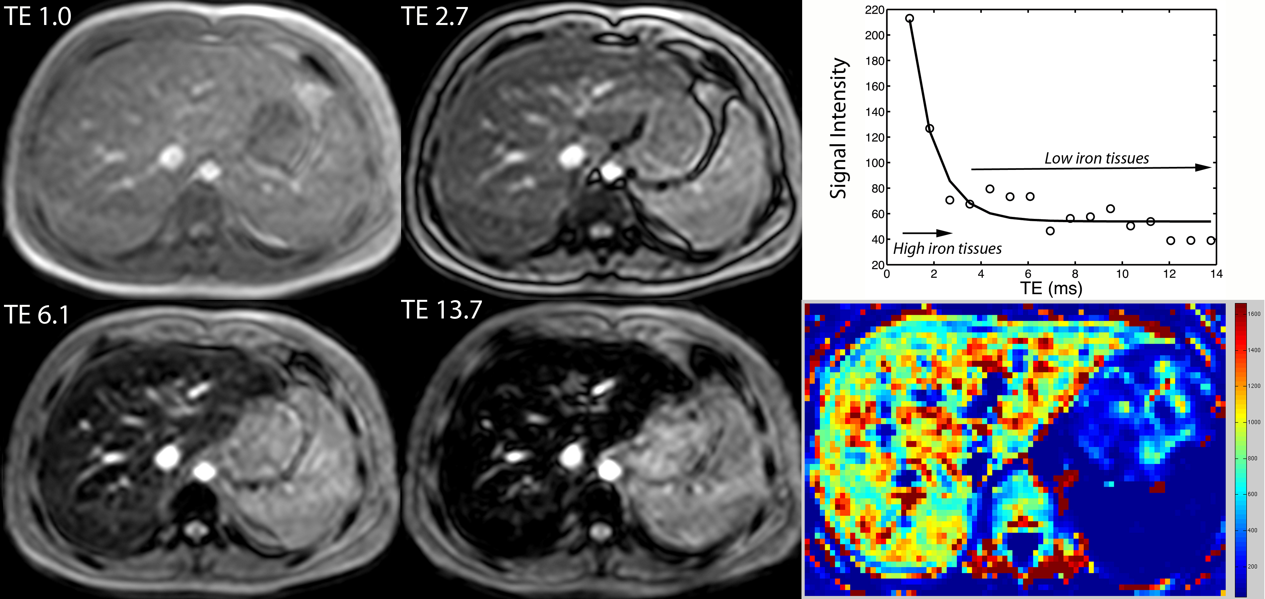
Principles of Iron Measurement
T2* = half life
R2* = rate = 1000/T2*

Slide 4
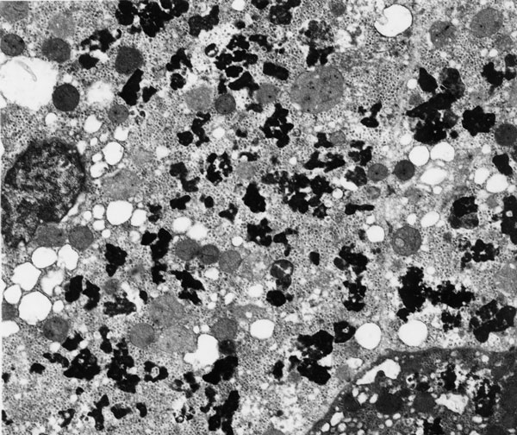
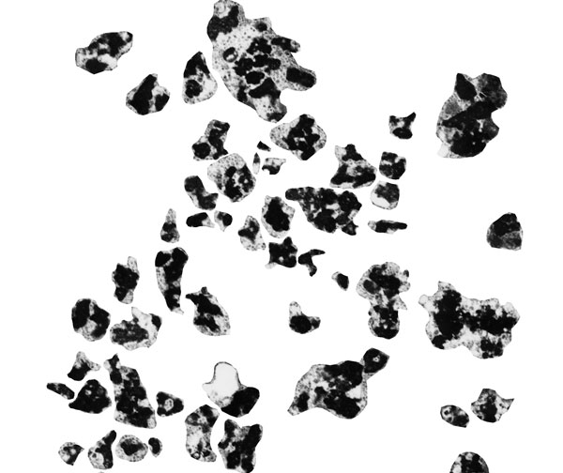
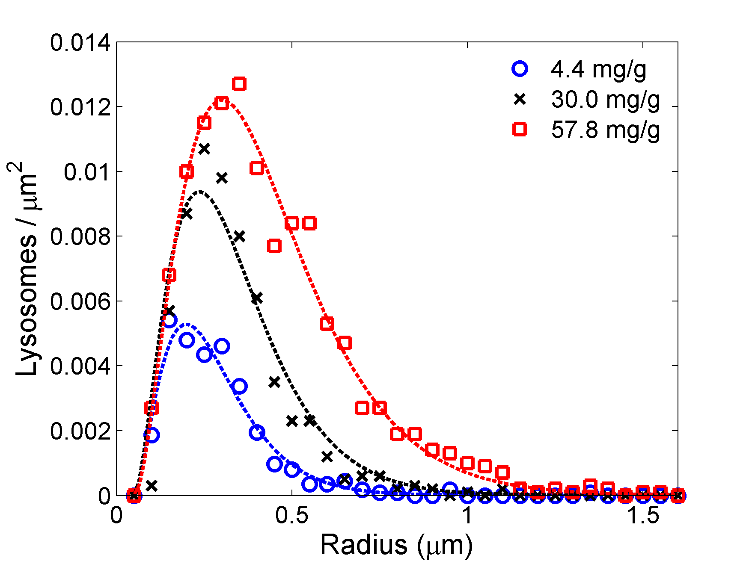
Electron Microscopy: Cellular iron size distribution
11 um
20 patients ( 1.4 – 57.8 mg/g )
20 snapshots each, 9000x
0.9 um
With increase in iron burden,
peak shifts to the right and area of the distribution increases → particles get larger and are greater in number.
Ghugre N, et al, J Microscopy 238(3):265-2724, 2010

Slide 5
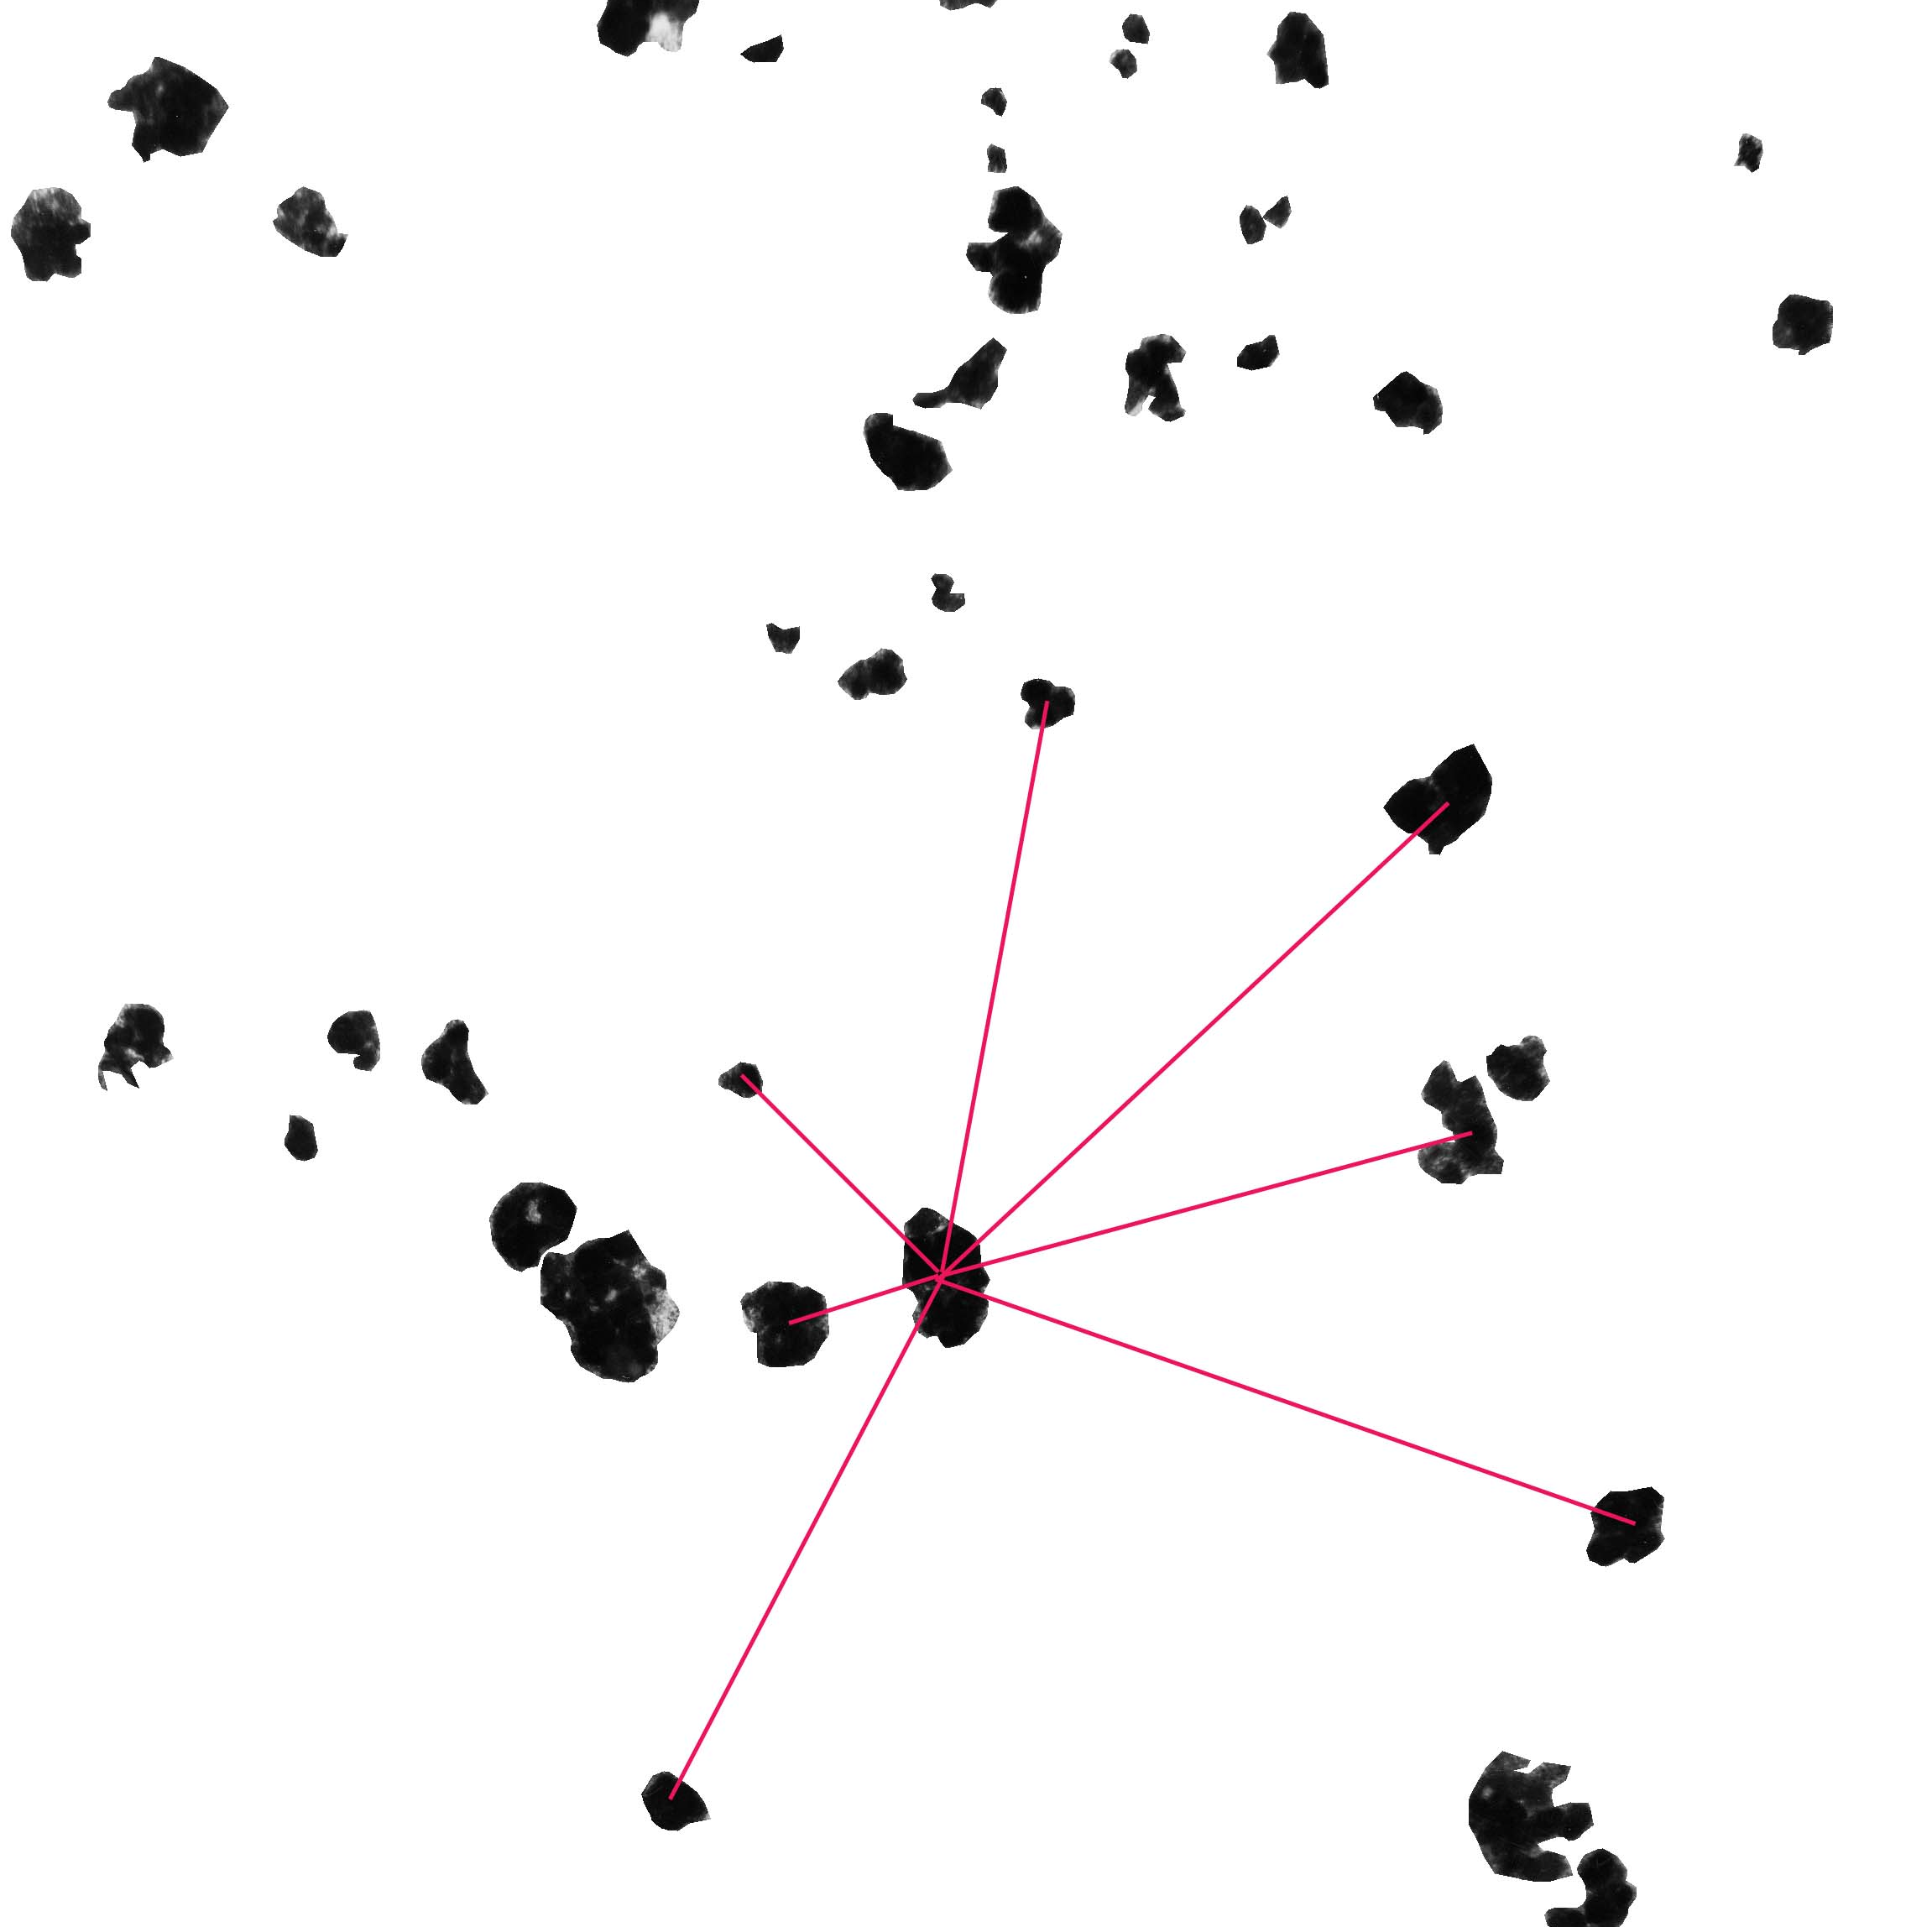
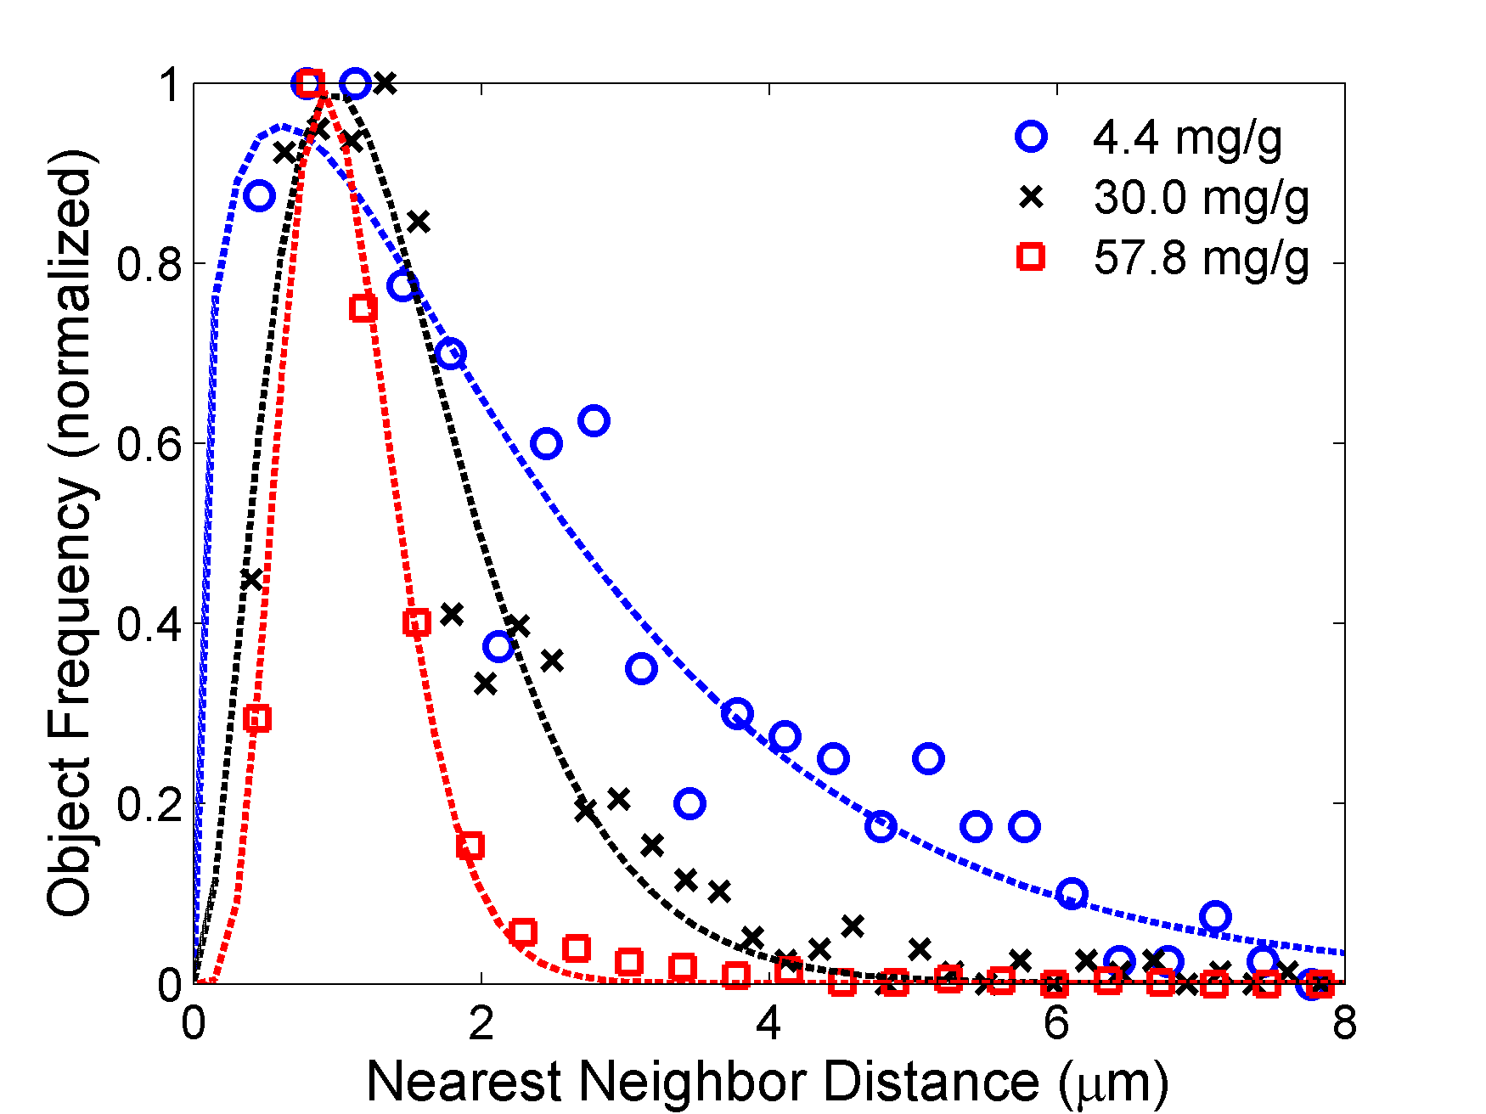
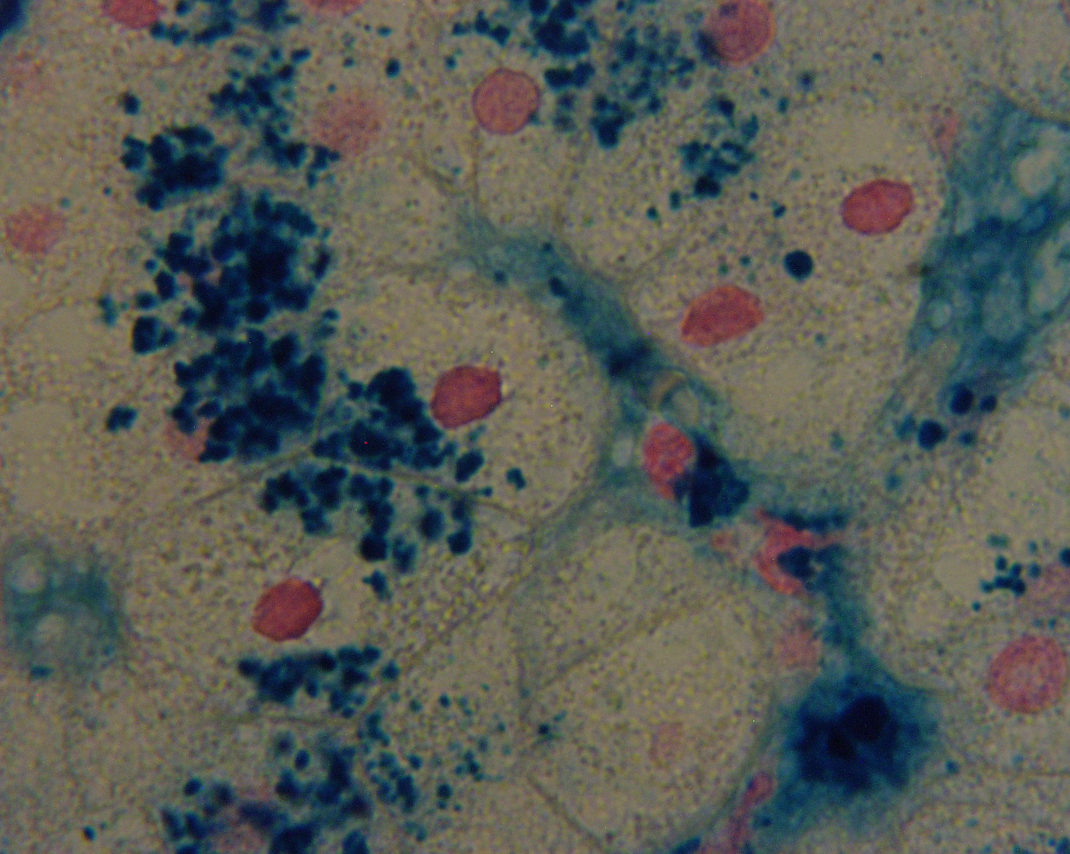
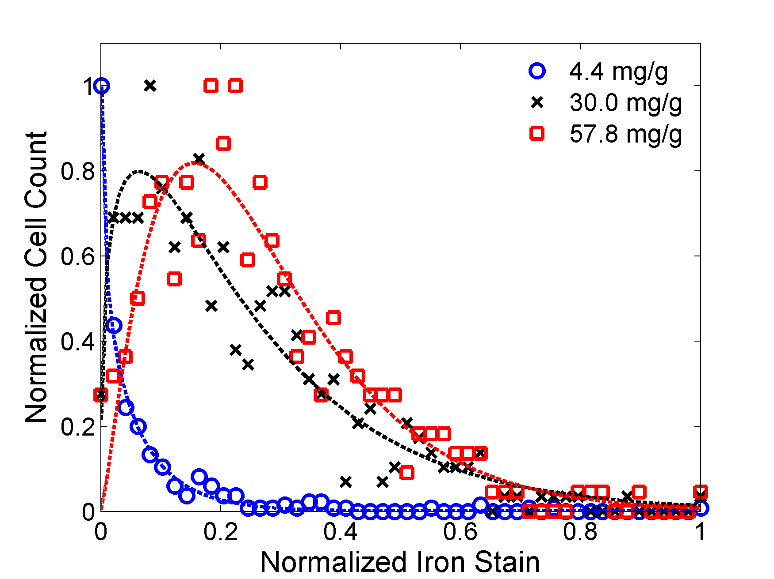
Inter-particle distance, Inter-cellular variation
Ghugre N, et al, J Microscopy 238(3):265-2724, 2010

Slide 6
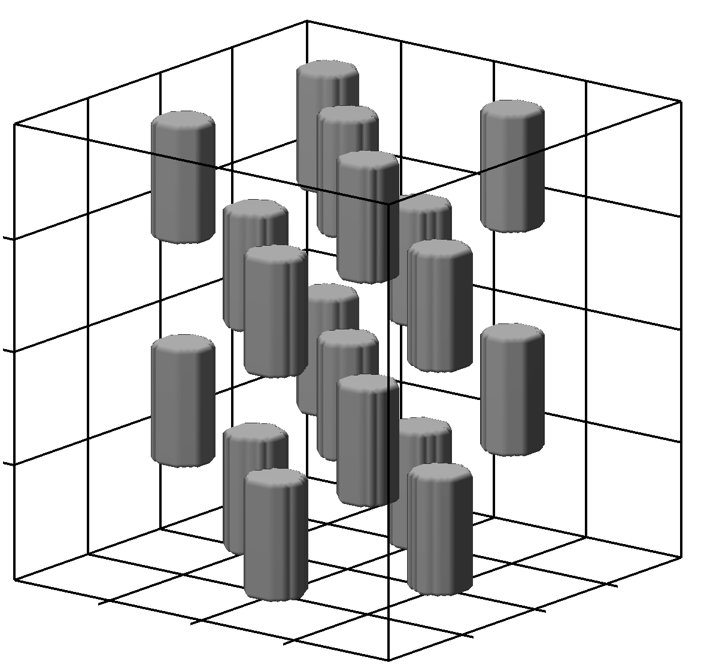
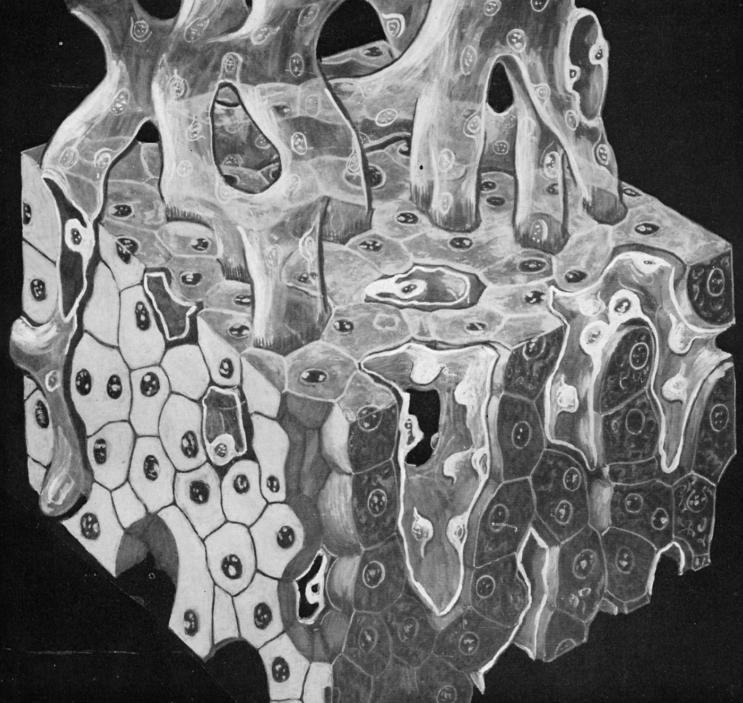
Virtual Liver Model
Cuboidal environment (80 µm side) → mimic liver tissue.
64 hepatocytes, 20 µm side cubes (approximation to hexagonal hepatocyte shape).
10 µm diameter cylindrical sinusoids (~6% by volume).
Portal tracts were neglected.
Spherical iron particles were assigned to hepatocytes and sinusoids based on inter-compartment prevalence.
Distribution was based on size, cellular anisotropy and inter-particle distances according to GDF’s.
Sphere were placed in a non overlapping manner.

Slide 7
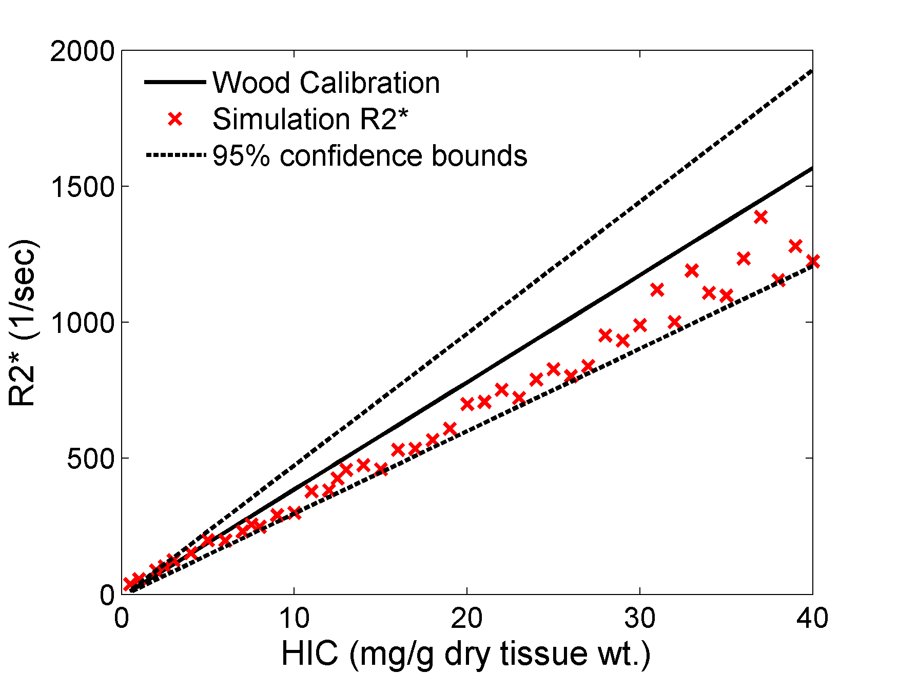
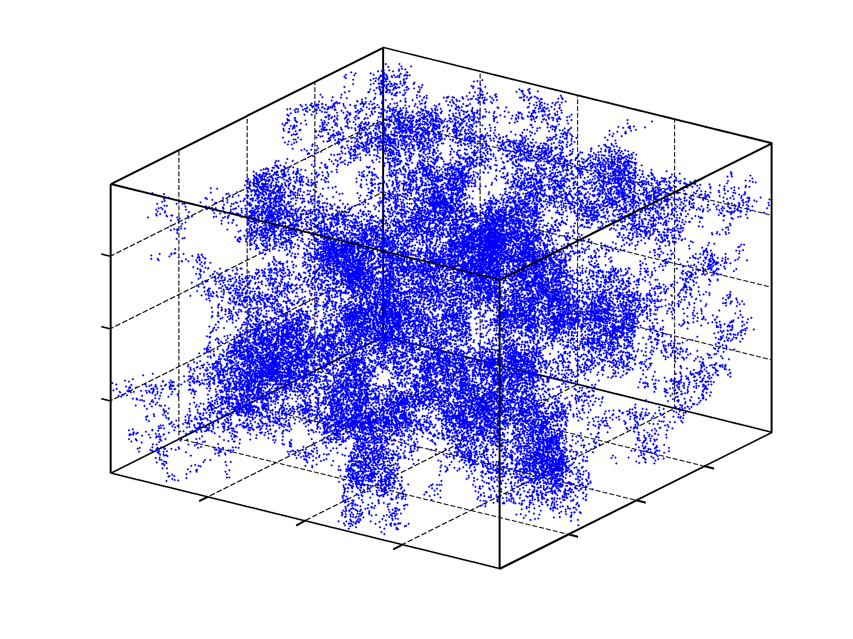
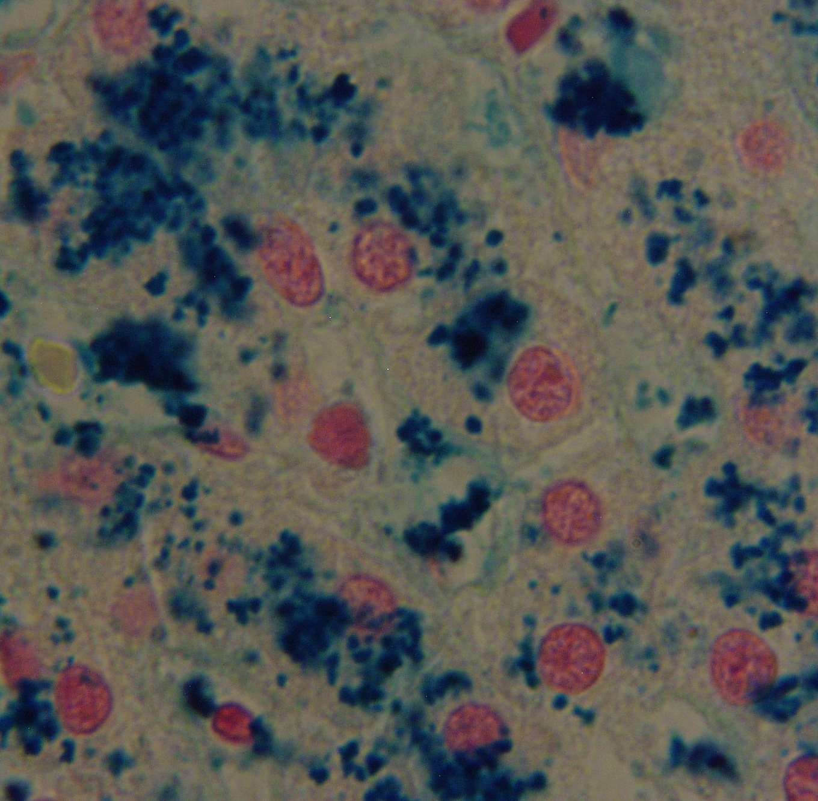
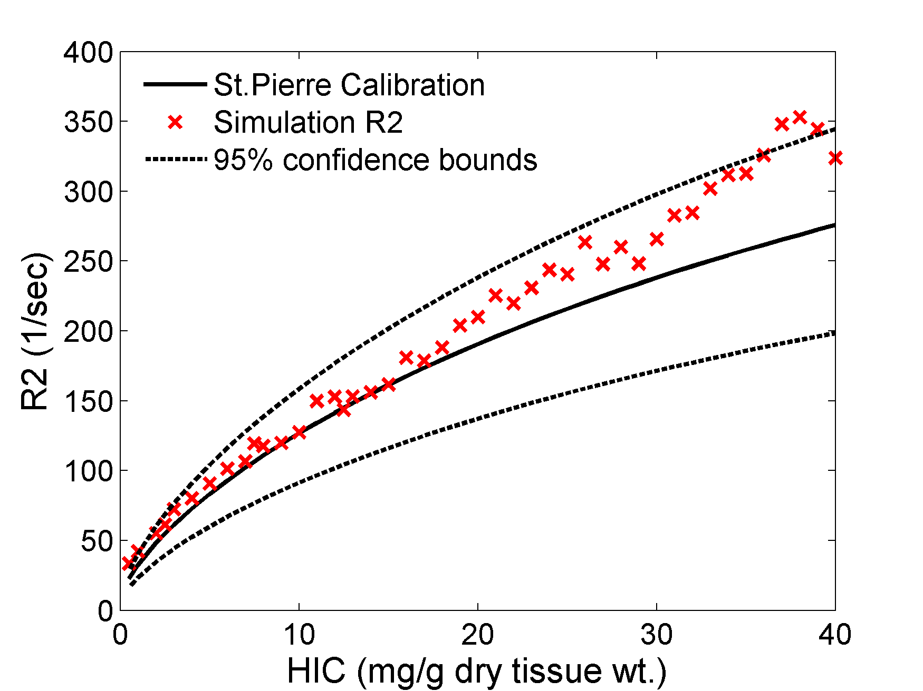
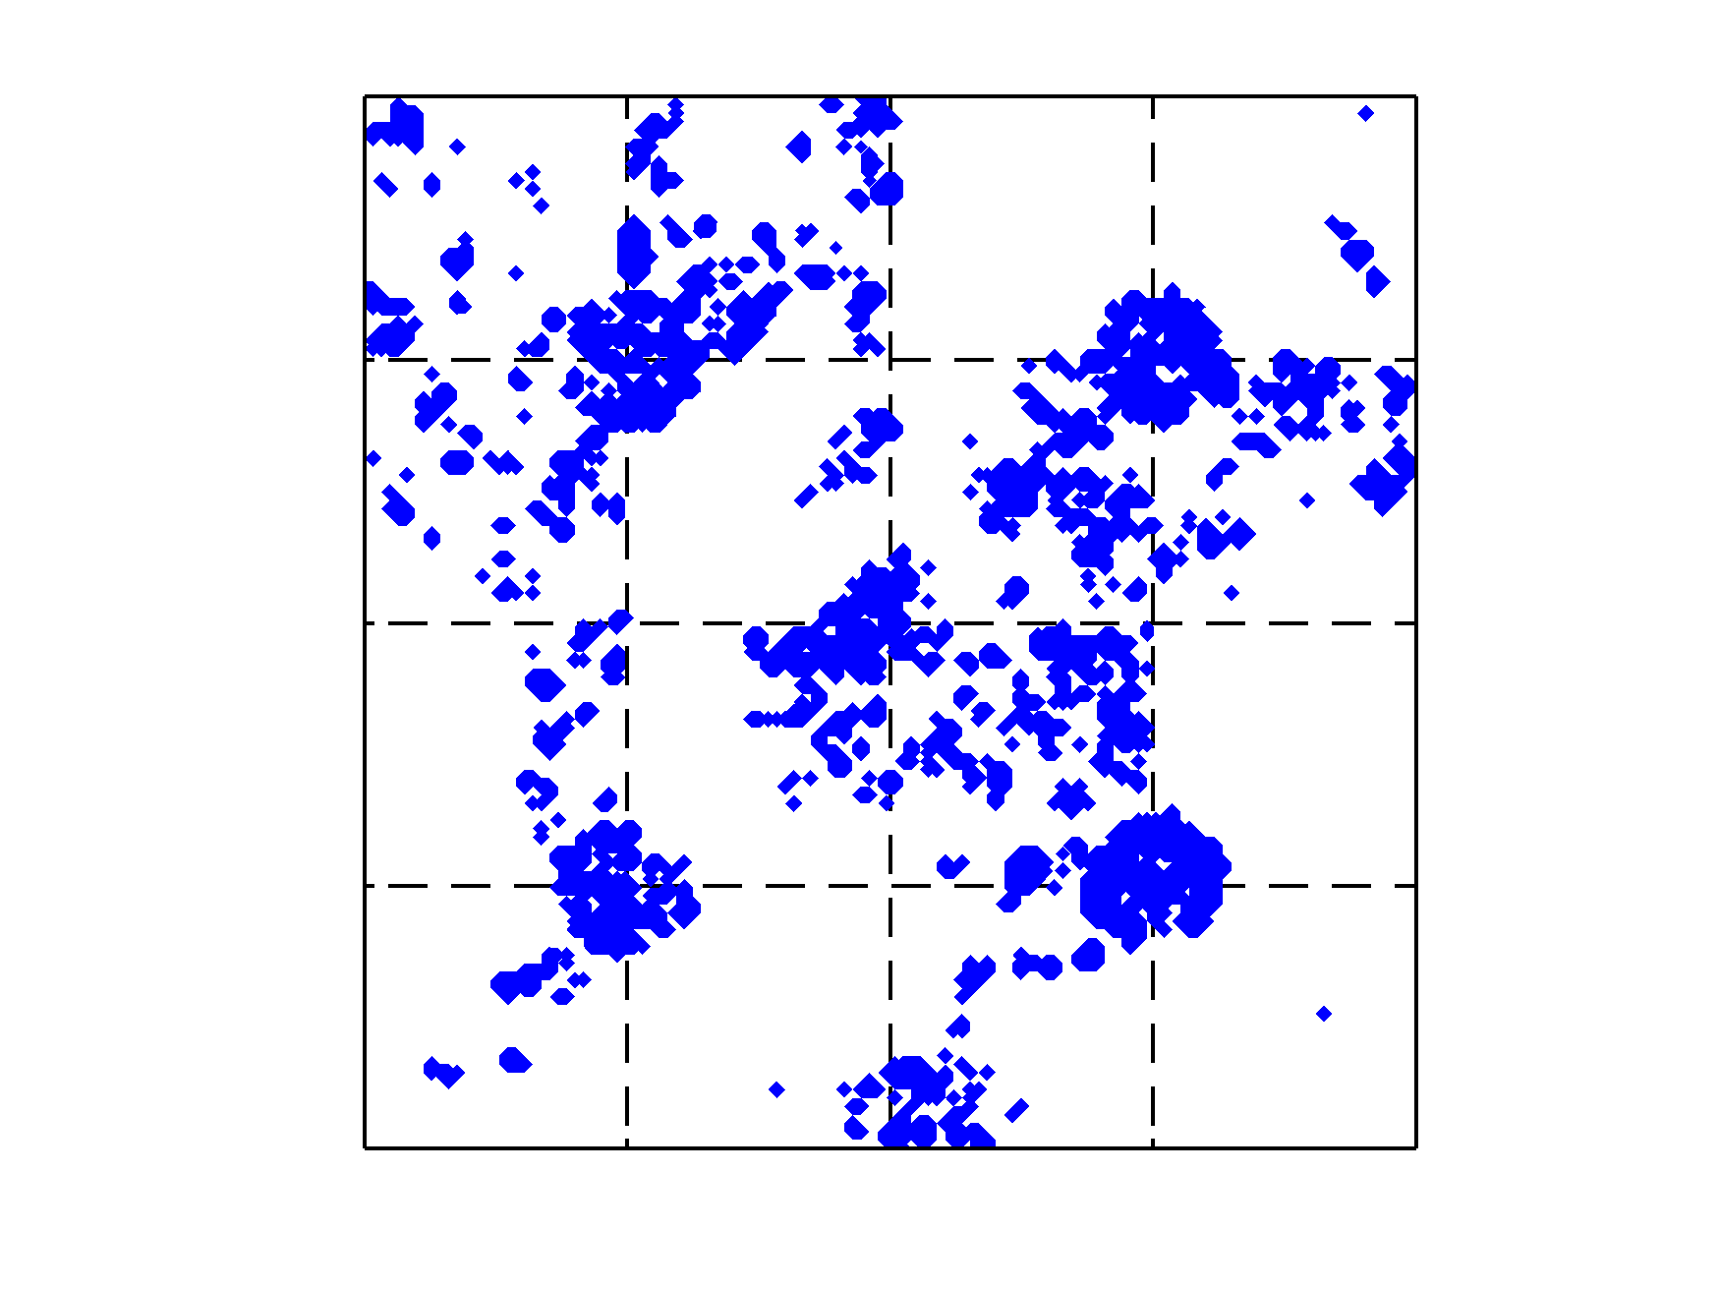
- 16 %
Final MRI calibration predicted by model
Particle size characterization
Inter-cellular iron anisotropy
Inter-particle distance
Sinusoids
Restricted motion
12 %
Ghugre et al, Mag Res Med, 65(3):837-847, 2011

Slide 8
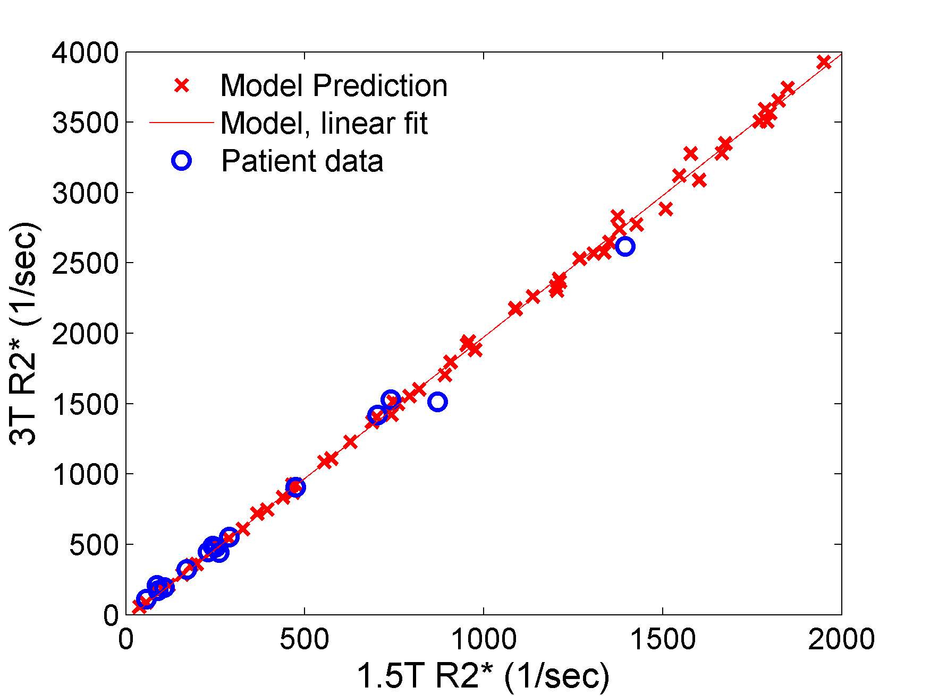
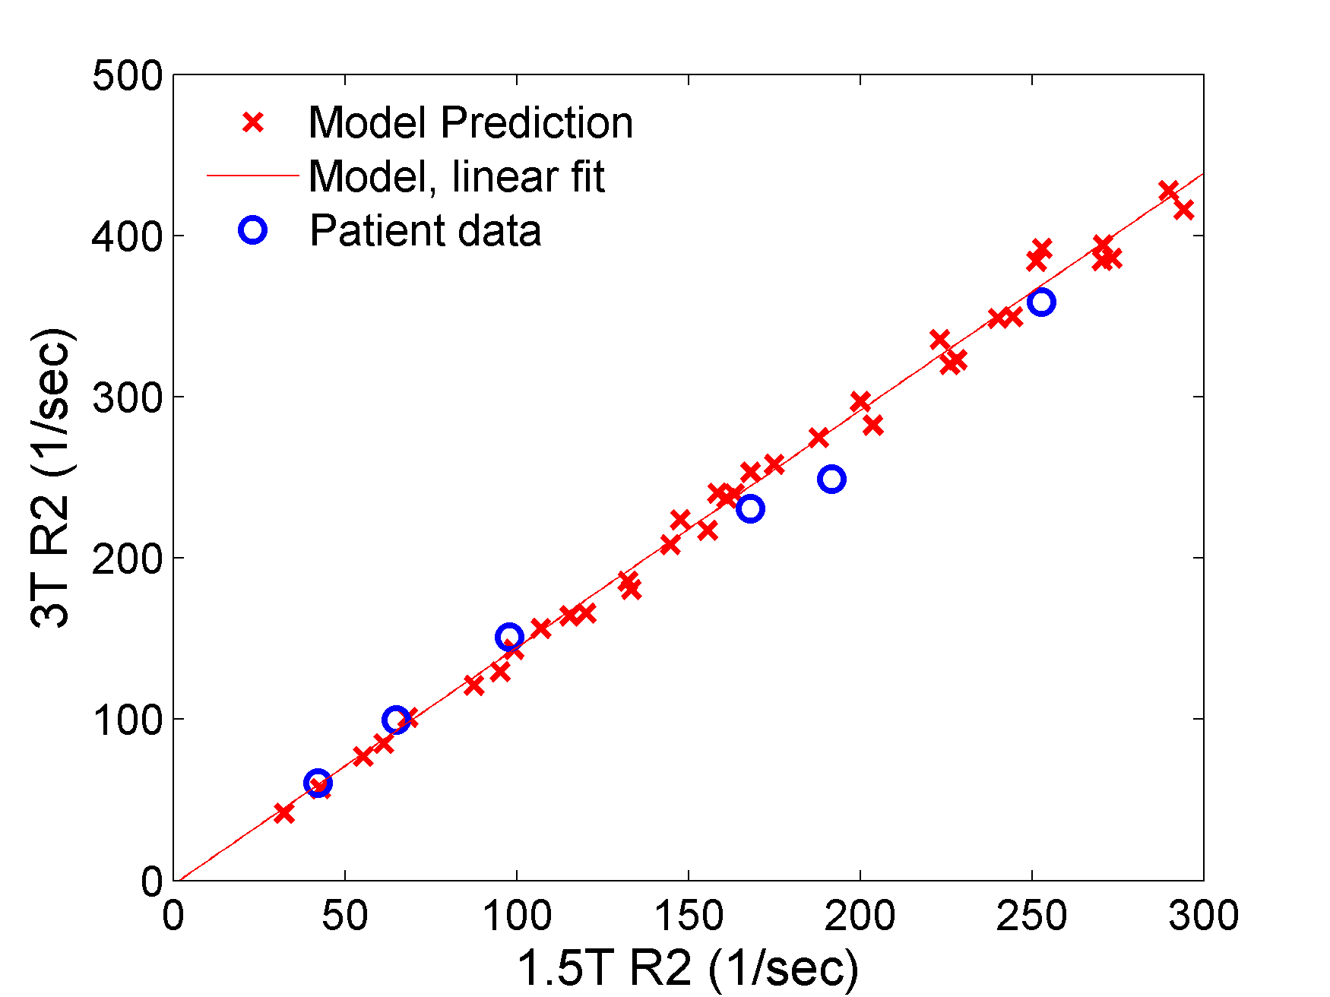
Model Validation (3T vs 1.5T)
y = 2x-35
R² = 0.9986
p < 0.0001
y = 1.47x-2.2
R² = 0.9958
p < 0.0001
R2* doubles at 3T
R2 is 47% higher at 3T
Storey et al., JMRI 25:540-7, 2007
Ghugre, et al, Mag Res. Med, 74(3):879-83, 2015

